Slide 1
Core Java
Java Database Connectivity

Slide 2

Lesson Objectives
In this lesson, you will learn:
  Introduction to JDBC
  Database Connectivity Architecture
  JDBC APIs
  Database Access Steps
  Using RowSets
  Using Transactions
  JDBC Best Practices

Slide 3
Introduction to JDBC
Let us discuss Java Database Connectivity (JDBC) with respect to the following:
  What is JDBC?
  What does JDBC do?
  Why JDBC?

Slide 4
What is JDBC?
Java Database Connectivity (JDBC) is a standard SQL database access interface, providing uniform access to a wide range of relational databases.
JDBC is used to allow Java applications to connect to the database and perform different data manipulation operations such as insertion, modification, deletion, and so on.
JDBC provides different set of APIs to perform operations related to database.

Slide 5
What does JDBC do?
JDBC allows us to construct SQL statements and embed them inside Java API calls.
JDBC makes it possible to do three things:
  Establish a connection with a database.
  Send SQL statements.
  Process the results.

Slide 6
Why JDBC?
JDBC exhibits the following features:
  Java is a write once, run anywhere language.
  Java based clients are thin clients.
  It is suited for network centric models.
  It provides a clean, simple, uniform vendor independent interface.
  JDBC supports all the advanced features of latest SQL version
  JDBC API provides a rich set of methods.
  With the JDBC API, no configuration is required on the client side.

Slide 7
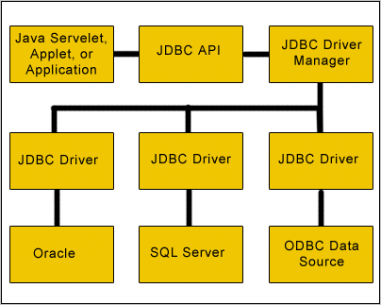
Database Connectivity Architecture
Layers of JDBC Architecture

Slide 8
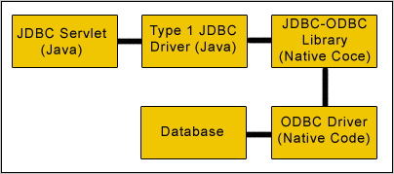
Type 1 – JDBC-ODBC Bridge
Type 1 – JDBC-ODBC Bridge

Slide 9
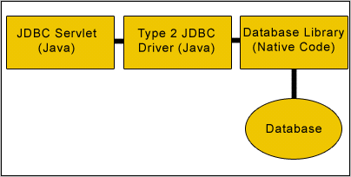
Type 2 – Java Native API
Type 2 – Java Native API

Slide 10
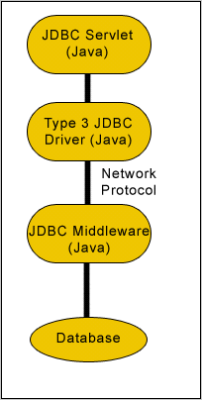
Type 3 – Java to Network Protocol
Type 3 – Java to Network Protocol

Slide 11

Type 4 – Java to Database Protocol
Type 4 – Java to Database Protocol

Slide 12
JDBC API Packages
JDBC packages:
  java.sql.*
  javax.sql.*

Slide 13
java.sql package
Driver
Connection
ResultSet
Interfaces in java.sql
DatabaseMetaData
ResultSetMetaData
Statement
PreparedStatement
CallableStatement

Slide 14
javax.sql package
DataSource
PooledConnection
RowSet
Interfaces in javax.sql
RowSetReader
RowSetWriter
XAConnection
XADataSource
RowSetMetaData

Slide 15
Database Access Steps
Database Access takes you through the following steps:
  Import the packages
  Register/load the driver
  Establish the connection
  Creating JDBC Statements
  Getting Data from a Table
  Insert data into Table
  Update table data
Notes:
Page 13-<number>
Core Java with JAXP Java Database Connectivity
13.4: Database Access Steps
13.4.1: Import the packages
13.4.2: Register the driver
13.4.3: Establishing the connection
13.4.4: Creating JDBC Statements
13.4.4.1: Simple Statement
13.4.4.2: Prepared Statement
13.4.4.3: Callable Statement
13.4.5: Getting Data from a Table
13.4.6: Insert data into Table
13.4.7: Update table data

Slide 16
Import Packages
Step 1: Import the java.sql and javax.sql packages
  These packages provides the API for accessing and processing data stored in a data source.
  They include:
    import java.sql.*;
    import javax.sql.*;

Slide 17
Register Driver
Step 2: Register/load the driver
  Class.forName("oracle.jdbc.driver.OracleDriver");
  Class.forName("com.mysql.jdbc.Driver");
  OR
  DriverManager.registerDriver (new oracle.jdbc.driver.OracleDriver());
  DriverManager.registerDriver (new com.mysql.jdbc.Driver());

Slide 18
Establish the Connection
Step 3: Establish the connection with the database using registered driver
  String url = "jdbc:oracle:thin:@hostname:1521:database";
  Connection conn = DriverManager.getConnection (url, "scott", "tiger");
  String url = "jdbc:mysql://localhost:3306/test";
  Connection conn = DriverManager.getConnection (url, “root", “root”);

Slide 19
Create Statement
Step 4: Create Statement
  Statement:
    Statement st=conn.createStatement();
  PreparedStatement:
    PreparedStatement pst=conn.prepareStatement(“select * from emp where eno=?”);
    pst.setInt(1,100);
  CallableStatement:
    CallableStatement cs=conn.prepareCall(“{ call add() }”) ;

Slide 20
Retrieve Data from Table
Step 5: Retrieve data from table
  Statement:
    Output:
      Display the no and name of all employees
  Statement st=conn.createStatement();
  ResultSet rs=st.executeQuery(“select * from emp”);
  while(rs.next()){
  System.out.println(“Emo No = ”+rs.getInt(“eno”));
  System.out.println(“Emo Name = ”+rs.getString(“ename”));
  }

Slide 21
Insert Data into Table
Step 6: Insert data into table
  Statement:
  Statement st=conn.createStatement();
  st.executeUpdate(“insert into emp values(110,’XYZ’,’Pune’)”);
  System.out.println(“ New Record is inserted”));

Slide 22
Update Table Data
Step 7: Update table data
  Statement:
  Statement st=conn.createStatement();
  st.executeUpdate(“update emp set ecity=’Mumbai’ where eno<1000)”);
  System.out.println(“Table updated”));

Slide 23
Demo: Database Access Demonstration
Demo with the following:
  Select
  Insert
  Delete
  Parameterized Query

Slide 24
Using RowSets
A RowSet object contains a set of rows from a result set or some other source of tabular data, such as a file or spreadsheet.
RowSet types include the following:
  JdbcRowSet: It is a connected scrollable, updatable RowSet
  CachedRowset: It is a disconnected RowSet
  WebRowSet: It is a connected RowSet that uses the HTTP protocol internally to talk to a Java Servlet that provides data access.
  FilteredRowSet: It is a WebRowSet with content filter.
  JoinRowSet: It joins multiple RowSets.

Slide 25
JdbcRowSet
A JDBCRowSet is a connected RowSet, which has a live connection to the database.
  ...
  RowSet rowset = new OracleJDBCRowSet(); rowset.setUrl("jdbc:oracle:thin:@192.168.67.177:trgdb”);
  rowset.setUsername(“user2");
  rowset.setPassword(“user2");
  rowset.setCommand("SELECT empno, ename, sal FROM emp");
  rowset.execute();
  while (rowset.next()) {
  System.out.println("empno: " + rowset.getInt(1)); System.out.println("ename: " + rowset.getString(2)); System.out.println("sal: " + rowset.getInt(3));
  } ...

Slide 26
CachedRowSet
A CachedRowSet is a RowSet in which the rows are cached and the RowSet is disconnected.
  ...
  RowSet rowset = new OracleCachedRowSet(); rowset.setUrl("jdbc:oracle:thin:@192.168.67.177:trgdb”);
  rowset.setUsername(“user2");
  rowset.setPassword(“user2");
  rowset.setCommand("SELECT empno, ename, sal FROM emp");
  rowset.execute();
  while (rowset.next()) {
  System.out.println("empno: " + rowset.getInt(1)); System.out.println("ename: " + rowset.getString(2)); System.out.println("sal: " + rowset.getInt(3));
  } ...

Slide 27
Using Transaction
A transaction is a set of one or more statements that are executed together as a unit, so either all of the statements are executed, or none of the statements is executed.
Java application uses Java Transaction API(JTA) to manage the transactions.

Slide 28
Disabling Auto-commit Mode
When a connection is created, it is in auto-commit mode.
To allow two or more statements to be grouped into a transaction is to disable auto-commit mode.
Example:
  con.setAutoCommit(false);

Slide 29
Committing a Transaction
After you complete execution of all the SQL statements, you should commit the transaction by calling commit().
  ...
  con.setAutoCommit(false);
  PreparedStatement updateSal = con.prepareStatement( "UPDATE Employee set sal =sal+1000 WHERE empno>?");
  updateSal.setInt(1, 50);
  updateSales.executeUpdate();
  PreparedStatement updateDept = con.prepareStatement( "UPDATE Employee set deptno=10 WHERE empno>?");
  updateTotal.setInt(1, 30);
  updateDept.executeUpdate();
  con.commit();
  ...

Slide 30
When do you call the Rollback Method
The rollback() method plays an important role in preserving data integrity in the transaction.
When you want to undone the changes of half done transaction due to SQLException:
    ...
  try {
  con.setAutoCommit(false);
  // perform transactions
  con.commit();
  con.setAutoCommit(true);
  } catch (SQLException e) {
  con .rollback() ;
  }

Slide 31
Demo : Transactions
Transaction

Slide 32
Connection Pooling
Let us discuss Connection Pooling with respect to the following points:
  Introduction to Connection Pooling
  DataSource Object
  DataSource versus DriverManager

Slide 33
Introduction to Connection Pooling
Acquiring and releasing connection is expensive.
Database connection pooling promotes reusability of the connection.
It increases the application performance, concurrency, and scalability.
It is implemented as DataSource Object.

Slide 34
DataSource Object
DataSource object can be thought of as a factory for connections to the particular data source.
A DataSource has a set of properties that identify and describe the real world data source.
A data source can reside on a remote server, or it can be on a local desktop machine.
A call to the getConnection() method returns a connection object.

Slide 35
Example
Let us see an example for using DataSource Object:
  ...
  OracleDataSource ods = new OracleDataSource();
  ods.setUser(“user2");
  ods.setPassword(“user2");
  ods.setDriverType("thin");
  ods.setNetworkProtocol("tcp");
  ods.setURL("jdbc:oracle:thin:@192.168.67.177:1521:trgdb");
  Connection conn = ods.getConnection();
  contd.

Slide 36
Example
  Statement stmt = conn.createStatement ();
  ResultSet rset = stmt.executeQuery ("select ename from Emp");
  while (rset.next ()){
  System.out.println (“Employee name is " + rset.getString (1));
  }

Slide 37
DataSource versus DriverManager
Let us do a quick comparison between DataSource and DriverManager:
DataSource | Driver Manager
Link with database is retained after closing the database connection. | Link is lost.
Database connection is reusable. | Database connection is not reusable.
Connection pooling feature is used. | Connection pooling is not implemented.
Distributed transactions are possible. | Distributed transactions are not possible
JNDI lookup is used. | JNDI lookup is not used.

Slide 38
Demo : DataSource
DataSource

Slide 39
JDBC Best Practices
Let us discuss some of the best practices in JDBC:
  Selection of Driver
  Tune connection pool size
  Close resources as soon as you’re done with them
  Turn-Off Auto-Commit – group updates into a transaction

